Slide 1
INVENTORY APPLICATION
HOW TO CREATE A VISUAL APPLICATION FROM BEGINNING TO END

Slide 2
INVENTAR APLIKACIJA
The bookstore at the faculty received textbook cards. Each shipment contains the same number of textbooks. The inventory manager wants to use a computer to calculate the total number of textbooks that arrive at the bookstore for each shipment. The inventory manager will enter the number of received cards and a fixed number of textbooks in each shipment card.
The application should then calculate and display the total number of textbooks in the shipment.

Slide 3
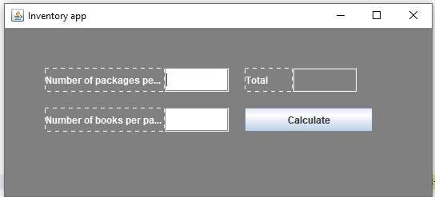
Inventory application

Slide 4
Inventory application-procedure
Create a new project
Create a visual part of the application, ie. Graphical User Interface (GUI)
Implement a button event
Do the business logic of the application, ie. Perform the necessary calculations

Slide 5
INVENTORY APPLICATION-visual part
HOW TO CREATE A GUI WITHOUT FUNCTIONALITY

Slide 6
VISUAL PART OF THE APPLICATION
2
1
6
5
3
8
4
9
7

Slide 7
GRAPHIC USER INTERFACE-programming
Create an object Class object = new Constructor ();
Set object attributes objekat.setAttribut(new_value);
Connect objects to each other object1.add(object2);
Connecting JFrame and JPanel objects win.setContentPane(pan);

Slide 8
GUI-more about graphic objects
1-JFrame
2-JPanel

Slide 9
GUI-creation of objects 1 and 2
1-JFrame
2-JPanel
JFrame win=new JFrame(“Inventar App”);
JPanel pan=new JPanel();

Slide 10
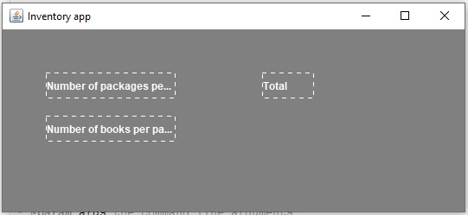
GUI-more about graphic objects
3 (JLabel)
5 (JLabel)
4 (JLabel)

Slide 11
GUI-Label Creation
3 (JLabel)
5 (JLabel)
4 (JLabel)
JLabel numberOfpackagesPerShipmentLab=new JLabel("Number of packages per shipment");
JLabel NumberOfBooksPerPackageLab=new JLabel("Number of books per package");
JLabel totalLab=new JLabel("Total");

Slide 12
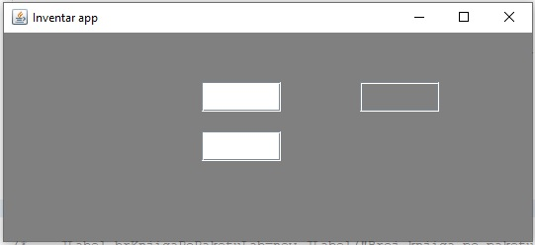
GUI-more about graphic objects
6 (JTextField)
8 (JTextField)
7 (JTextField)

Slide 13
GUI-Creating text fields
6 (JTextField)
8 (JTextField)
7 (JTextField)
JTextField numberOfpackagesPerShipmentTF
JTextField numberOfpackagesPerShipmentTF=new JTextField();
JTextField totalTF=new JTextField ();

Slide 14
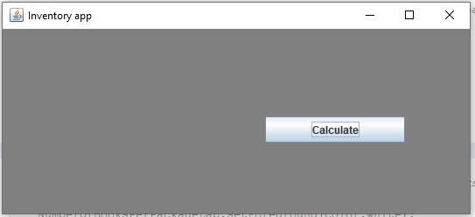
GUI-more about graphic objects
9(JButton)

Slide 15
GUI-Creating a JButton object
9(JButton)
JButton calculateButton=new JButton();

Slide 16
INVENTORY APPLICATION-visual part
OBJECTS SETTINGS

Slide 17
GUI-setting of the JFrame object
1-JFrame
SETTING SIZE
BEHAVIOR OF THE FRAME WHEN CLICKING ON THE X BUTTON
POSITION IN RELATION TO THE SCREEN
VISIBILITY
win.setSize(550,250)
win.setDefaultCloseOperation(JFrame.EXIT_ON_CLOSE)
win.setLocationRelativeTo(null)
win.setVisible(true)

Slide 18
GUI-setting of JPanel object
2-JPanel
BACKGROUND COLOR SETTING
win.setBackground(Color.gray)

Slide 19
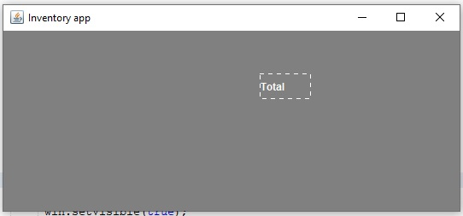
GUI-Setting of the JLabel class object
X
(0,0)
300
50
5 totalLab(JLabel)
totalLab.setText(“Ukupno”);
totalLab.setSize(60,30);
Y
totalLab.setBounds(300,50,60,30);

Slide 20
GUI-Configuration of the JTextField class object
X
(0,0)
60
50
8- totalTF(JTextField)
totalTF.setSize(80,30);
totalTF.setBounds(360,50,80,30);
Y

Slide 21
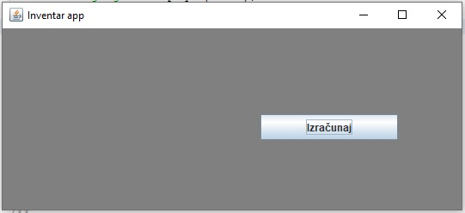
GUI-Setting of the JButton class object
X
(0,0)
100
300
9- calculateButton(JButton)
calculateButton.setSize(160,30);
calculateButton.setBounds(300,100,160,30);
Y

Slide 22
INVENTORY APPLICATION-visual part
CONNECTING OBJECTS

Slide 23
GUI-connecting objects 1 and 2
1-JFrame
2-JPanel
win.setContentPane(pan);
If a new panel is created
pan=win.getContentPane();
Taking the existing object

Slide 24
INVENTORY APPLICATION-event button
adding method actionPerformed()

Slide 25
Add action listener
Connect the class to the interface ActionListener
Implement the method actionPerformed(ActionEvent e)
Create a current class object somewhere (ClassName) ClassName listener=new Constructor();
add the previous object to be the event listener for the button button.addActionListener(listener);

Slide 26
INVENTORY APPPLICATION-add business logic
method implementation actionPerformed()

Slide 27
Business logic(computational part without graphics)
int numberOfpackagesPerShipment, numberOfBooksPerPackage, total;
Scanner scanner= new Scanner(System.in);
numberOfpackagesPerShipment =scanner.nextInt();
numberOfBooksPerPackage =scanner.nextInt();
total = numberOfpackagesPerShipment * numberOfBooksPerPackage;
System.out.println(“”+total);

Slide 28
Business logic (computational with graphics)
int numberOfPackagesPerShipment, numberOfBooksPerPackage, total;
String numberOfPackagesPerShipmentStr, numberOfBooksPerPackageStr;
numberOfPackagesPerShipmentStr = numberOfPackagesPerShipmentTF.getText();
numberOfBooksPerPackageStr = numberOfBooksPerPackageTF.getText();
numberOfpackagesPerShipment= Integer.parseInt(numberOfpackagesPerShipmentStr );
numberOfpackagesPerShipmentStr = Integer.parseInt(numberOfpackagesPerShipmentStr );
total= numberOfBooksPerPackage * numberOfPackagesPerShipment;
totalTF.setText(“”+total);

Slide 29
INVENTORY APPLICATION-end
Thank you for your attention

